Slide 1
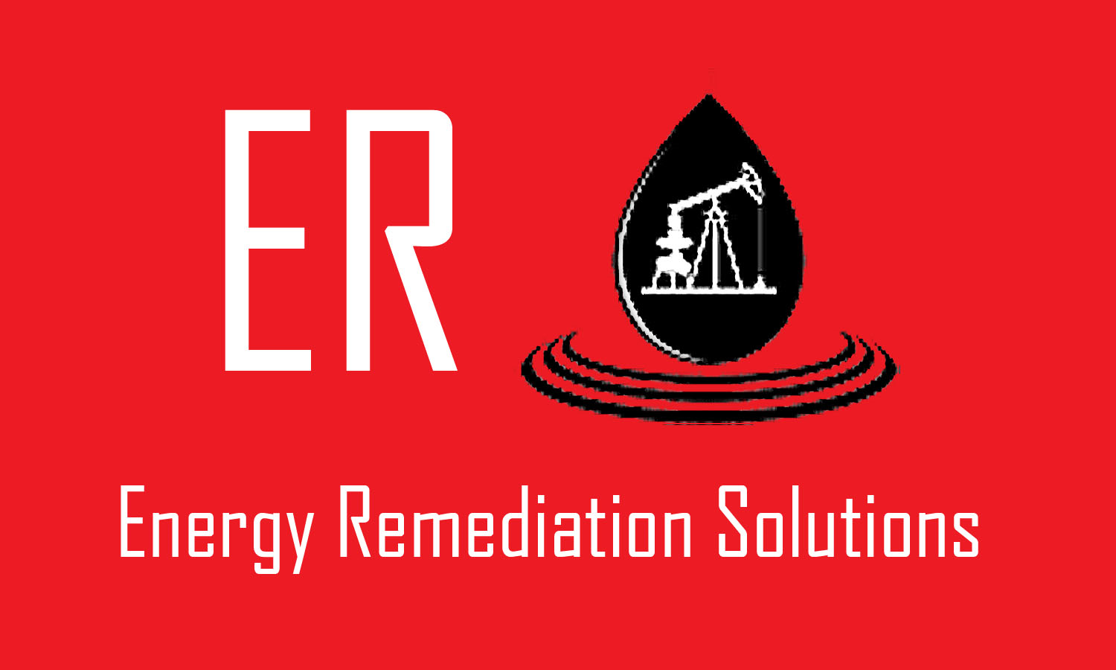
Energy Remediation solutions
Oilfield products
www.energyremediationsolutions.com

Slide 2
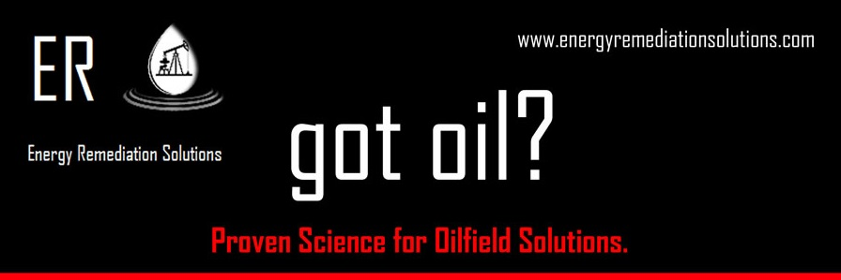
Safe, Sustainable and Economical Solutions for the Oil Field
MEOR, H2S, Paraffin, Scale, Corrosion, and Asphaltenes

Slide 3
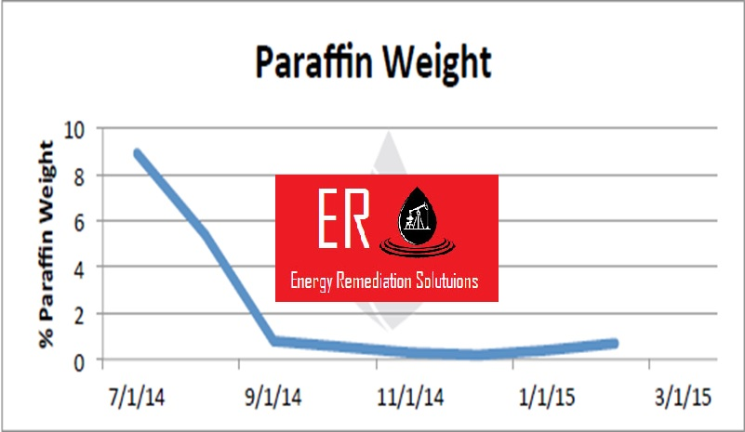
Advantages of Energy Remediation Solutions Oil field Products
Ecologically Friendly Microbial
Offering sustainable solutions to eliminate
H2S
Paraffin
Scale & Corrosion
Asphaltenes
Removes need for hazardous chemicals
Provides measurable results

Slide 4
Significantly lower expenses
Eliminates the need for chemical treatments, hot oil, and hot water treatments
Reduces the frequency of workover units to pull wells,
Lowers costs of replacing rods, tubing, pumps and lessens downtime
Reduces electricity costs by reducing drag incurred on rod pumps due to paraffin by reducing oil viscosity
Shifts hydrocarbon fraction to produce lighter, more profitable oil

Slide 5
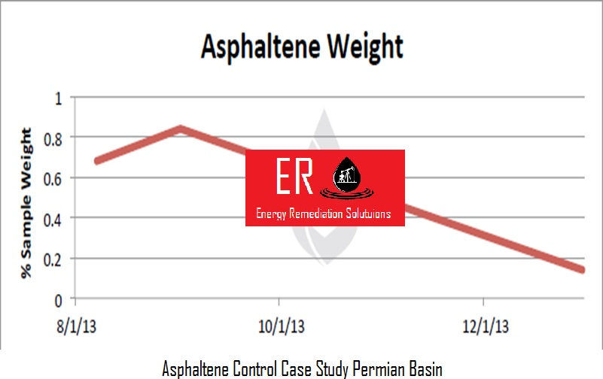
Applications for ERS products
Performance advantage in select markets
Paraffins, Asphaltenes, MEOR, SCALE, Frac Polymers, Well Stimulations, Hydrogen Sulfide Control, Water Quality

Slide 6
Comparison to traditional chemicals
Traditional Mechanisms
Solvents
Surfactants
New Mechanisms
Paraffin metabolism
Asphaltene control
Frac polymer repair
Emulsion Breaking

Slide 7
ERS Products General Characteristics
Safe to handle
Mixtures (ecosystems)
Chosen for specific activity
Chosen to eliminate undesirable properties
100% eco natural microorganisms

Slide 8
Environmental stewardship
All ERS products are among the safest used in the oilfield. Low in hazardous potential and non-pathogenic to humans, animals, the water supply, and safe for the environment
ERS offers safe effective treatments
New, innovative, clean
Microbes reduce operating costs and environmental liability Improve public image

